Slide 1

NS
LECTURE
Fundamentals of Network Security
Network Security
Diploma in CSF
Year 3 (2021/22), Semester 5
1

Slide 2
Objectives
At the end of this, you will get to know more about:
What is Network Security?
What are we trying to protect?
Subnets, NAT & VLAN to Improve Network Security
Intro to Palo Alto Firewall
Initial Configuration
Interface Types
Security Zones and Policy

Slide 3
What is Network Security?
Network Security is the control of unwanted intrusion into, use of, or damage to communications on your organization’s computer network.
Network security involves any and all countermeasures taken to protect a network from threats to its integrity.

Slide 4
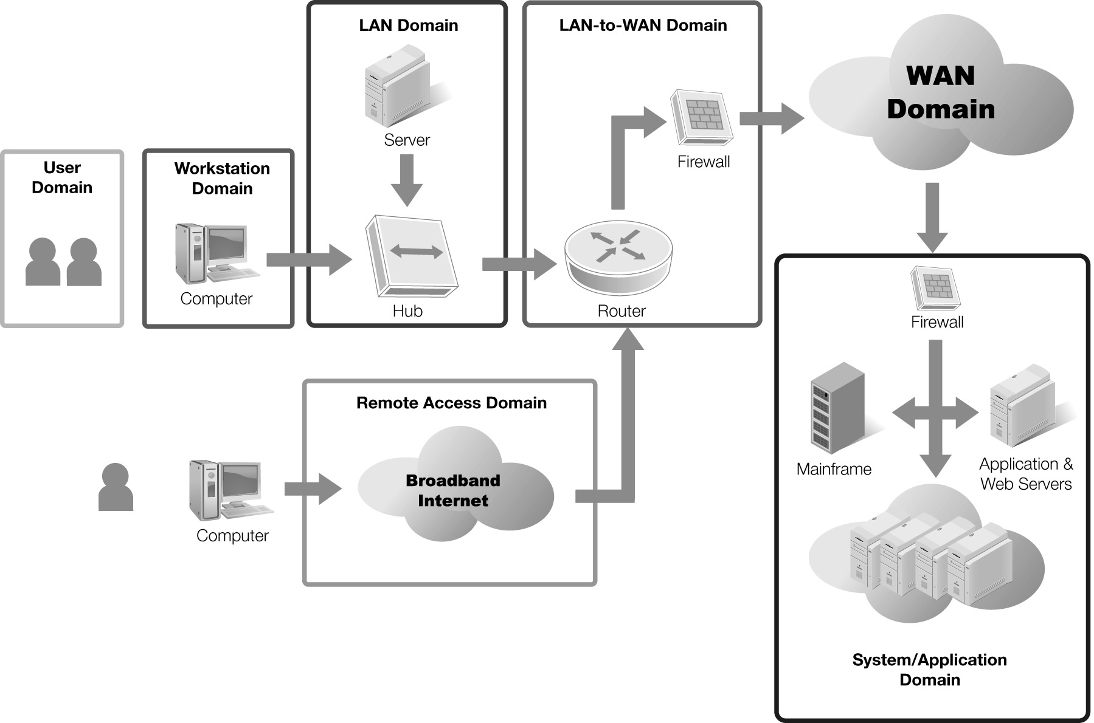
What are we trying to protect?
Seven Domains of a Typical IT Infrastructure

Slide 5
What are we trying to protect?
7 domains of a typical IT infrastructure
User Domain
Workstation Domain
LAN Domain
LAN to WAN Domain
Remote Access Domain
WAN Domain
Systems/Application Domain

Slide 6
What are we trying to protect?
User Domain – actual users (Employees, consultants, contractors or other third party users)
Workstation Domain – End-user’s desktop devices such as desktop computer, laptop, VoIP telephone or other end-point devices
LAN Domain – Physical and logical local area network (LAN) technologies (e.g. 1000 Mbps switched Ethernet, 802.11-family of wireless LAN technologies)
LAN to WAN Domain – organization’s internetworking and interconnectivity point between LAN and the WAN network infrastructure

Slide 7
What are we trying to protect?
Remote Access Domain – authorized and authenticated remote access procedures for users to remotely access the organization’s IT infrastructure, systems and data
WAN Domain – Organizations with remote locations require WAN to interconnect them
Systems/Application Domain – hardware, operating system software, database software, client/server applications, and data that is typically housed in the organization’s data center and/or computer rooms

Slide 8
Reflection - 1
Is there any technique you learnt in NF module for improving network security?

Slide 9
1. Security through Network Design
Subnetting
An IP address comprises two parts: one part is a network address and one part is a host address
Subnetting or subnet addressing
Splits a large block of IP addresses into smaller groups

Slide 10
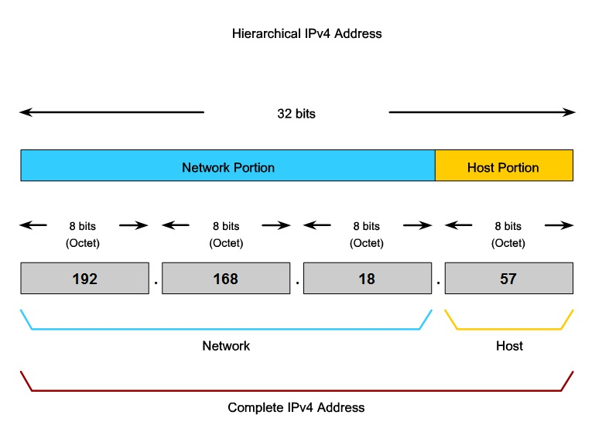
Subnetting Example

Slide 11
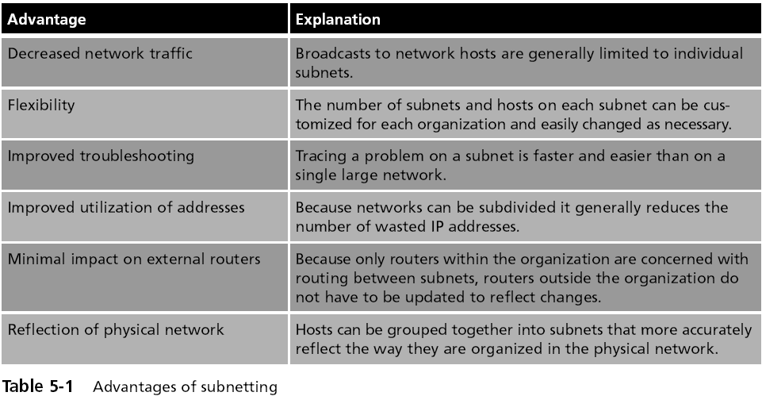
Advantages of Subnetting

Slide 12
Subnets Improve Security
Each subnet can be isolated from the rest of the network
Traffic between subnets can be monitored and restricted at the routers
Subnets also allow network administrators to hide the internal network layout
Outsiders only see your public servers, not your private subnets

Slide 13
Private Addresses
Can you identify the private and public addresses in this diagram?

Slide 14
Reflection - 2
Is there any technique you learnt in NI module for improving network security?

Slide 15
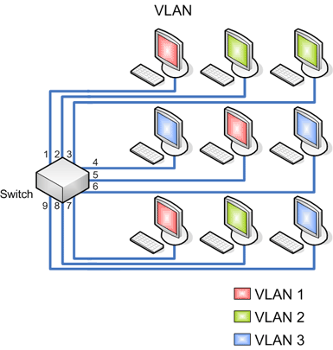
Virtual Local Area Network (VLAN)
VLANs segment a network with switches;
A VLAN allows scattered users to be logically grouped together even though they may be attached to different switches

Slide 16
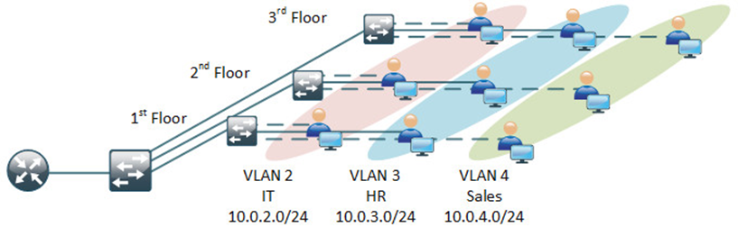
VLAN Example
A company with 3 floors;
Every floor is mixed with workstations from different department;
Through VLAN, every department can be logically grouped together.

Slide 17
VLAN Security
VLAN reduces network traffic and provide a degree of security similar to subnetting:
VLANs can be isolated so that sensitive data is transmitted only to members of the VLAN

Slide 18
Network Security Components
Network security components often include:
Network Anti-virus and anti-spyware
Intrusion detection systems (IDS), Intrusion prevention systems (IPS), to identify fast-spreading threats, such as zero-day or zero-hour attacks
Virtual Private Networks (VPNs), to provide secure remote access
Firewall, to block unauthorized access to your network
A firewall is a common network security system that monitors and controls the incoming and outgoing network traffic based on predetermined security rules.
A firewall typically establishes a barrier between a trusted, secure internal network and untrusted outside network, such as the Internet.

Slide 19
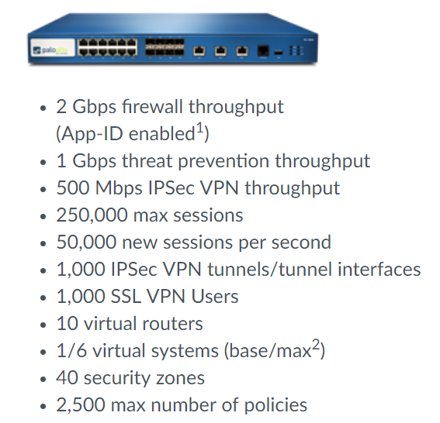
Intro to Palo Alto Firewall
You will have hands-on experience on PA-3020 firewall in our lab.

Slide 20

Initial Configuration
Management interface (MGT): This interface only passes management traffic for the device and cannot be configured as a standard traffic interface. Administrators use this interface for direct connectivity to the management plane of the firewall.
By default, this interface has an IP address of 192.168.1.1.
The default username of admin has a default password of admin.
Console interface: The console interface (serial interface) is usually a RJ-45 connection. The system defaults can be restored by performing a factory-reset of the device.
MGT
Console

Slide 21
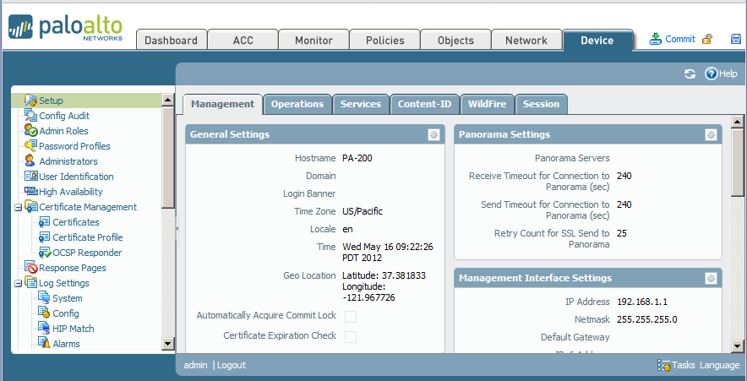
Configuring the MGT interface - GUI
Device > Management
Notes:
The MGT interface can also be set up with the GUI. Palo Alto Networks firewalls are configured with an IP address of 192.168.1.1 on the MGT interface by default.
Assign the Ethernet interface on your computer a 192.168.1.0/24 address e.g. 192.168.1.2/24 and connect to the MGT interface with an Ethernet cable. Launch a web browser connection to https://192.168.1.1 and log in using the default user name and password. Click Device > Setup > Management then click the button on the Management Interface Settings panel. From this location, you can set the networking information for the MGT interface of your firewall.

Slide 22
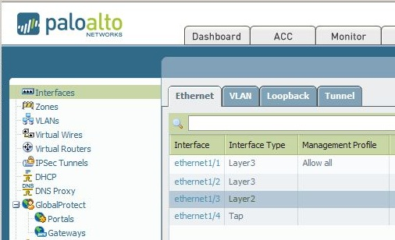
Physical Interfaces
Palo Alto Firewall 3000 series has 12 physical interfaces (ports) can be connected to other networking device (switch, router, pc and etc.)
The firewall supports a wide range of deployment options and interface types that can be used simultaneously on different physical interfaces.
Common interface types:
Tap
Layer 2
Virtual Wire (To be covered in Week 2)
Layer 3 (To be covered in Week 2)

Slide 23






Tap Interfaces
Passive Interface
By utilizing tap mode interfaces, the device can be connected to a core switch’s SPAN or mirror port to identify applications running on the network.
This option requires no changes to the existing network design.
In this mode the device cannot block traffic or filter based on URL.
Internet
LAN
E1/1
SPAN Port

Slide 24
Layer 2 Interface
In a Layer 2 deployment, the firewall provides switching between two or more networks.
Each group of interfaces must be assigned to a VLAN object.
Layer 2
Mail Servers
(10.20.1.0/24)
E1/3
E1/4
E1/5
Switching between network segments
Internet
LAN
(10.20.1.0/24)
App Servers
(10.20.1.0/24)

Slide 25
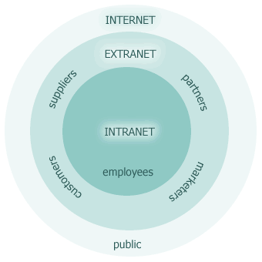
Traditional Zones of Risk
Risk and trust levels of common network zones
Zone | Risk Level | Trust Level
LAN | Low | High
Extranet | Medium-Low | Medium-High
DMZ | Medium-High | Medium-Low
Internet | High | Low

Slide 26
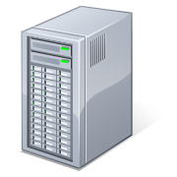



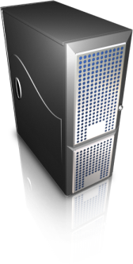
Security Zone Overview
Palo Alto Network firewalls use the concept of security zones. Zones are a logical grouping based on a particular type of traffic on your network. The physical location of the traffic is irrelevant. Zone names have no predefined meaning or policy associations.
Systems with similar security needs are grouped into zones. For example, we would expect to see traffic initiated from the internet making connections into the DMZ, but we would never want to see that same kind of traffic into the datacenter.
Zones represent networks of differing trust levels
DMZ
Internet
Guests
Users
Data Center

Slide 27
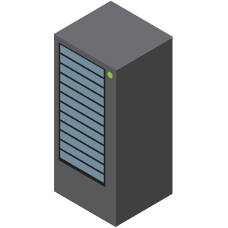


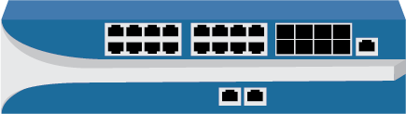


Security Zones and Security Policy Rules
Traffic within a zone is allowed by default.
Traffic between zones is denied by default.
Internet
DMZ
Guest
Users
Data Center

Slide 28
Security Policy Rule
When you define a security policy rule, you must specify the source and destination security zones of the traffic. Separate zones must be created for each type of interface (Layer 2, Layer 3, virtual wire, tap) and each interface must be assigned to a zone before it can process traffic.
Security policies can be defined only between zones of the same type.
Security policies are evaluated in the order they are listed in the firewall. Traffic is compared against each rule in the list. If the traffic matches the rule, no further rules are evaluated. If the rule does not match, the next rule is checked.

Slide 29
Implicit Rule & Explicit Rule
A Palo Alto Networks firewall enforces two implicit rules if traffic has not matched any user defined security policies:
Traffic within a single zone (intra-zone) is allowed.
Traffic between two zones (inter-zone) is denied.
These two rules are processed after all user defined rules. Implicit rules do not generate traffic log entries.
Caution: An explicit “deny-all” rule at the end of the user-defined policies will be processed before the implicit rules, denying intra-zone traffic.

Slide 30
Summary
Fundamentals of Network Security?
Seven Domains of Protection
Subnets, NAT & VLAN to Improve Network Security
Intro to Palo Alto Firewall
Initial Configuration
Interface Types
Security Zones and Policy

